Slide 1

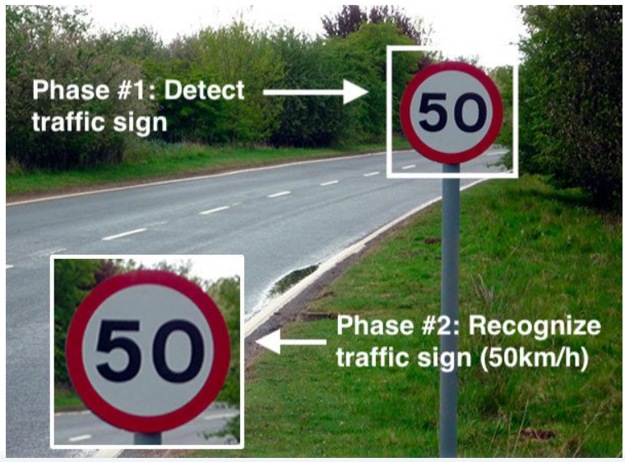
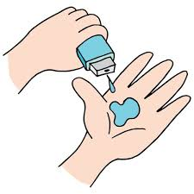
Code Conquers
Traffic Sign Classifier
Gratitude develops faith. The surest path out of a slump is marked by the road sign "thank you, God."
-Max Lucado

Slide 2





PROJECT TITLE:
Traffic Sign Classification Using Convolution Neural Network

Slide 3



AGENDA
PROGBLEM STATEMENT
PROJECT OVERVIEW
PURPOSE
END USERS
TENHNOLOGY UTILIZE
SOLUTION AND VALUE PROPOSITION
CONCLUSION

Slide 4




PROBLEM STATEMENT
Automated traffic sign recognition is an important part of a driver assistance system. In this research work, algorithms are developed using Convolution Neural Network to recognize traffic signs while the camera is in motion.
The work was mainly focused on automatic recognition of warning signs placed in local roads.

Slide 5

PROJECT OVERVIEW
In this Deep Learning project, we will build a model for the classification of traffic signs available in the image into many categories using a Convolutional neural network(CNN) and Keras library.
Dataset is consists of more than 50,000 pictures of various traffic signs(speed limit, crossing, traffic signals, etc.) Around 43 different classes are present in the dataset for image classification.
It contains two separate folders, train and test, where the train folder is consists of classes, and every category contains various images.

Slide 6





WHO ARE THE END USERS?
In this era of Artificial Intelligence, humans are becoming more dependent on technology. With the enhanced technology, multinational companies like Google, Tesla, Uber, Ford, Audi, Toyota, Mercedes-Benz, and many more are working on automating vehicles. They are trying to make more accurate autonomous or driverless vehicles

Slide 7





TECHNOLOGY UTILIZE
Machine Learning
Deep Learning Concept
Convolutional Neural Network
Python libraries
Relevant Dataset Selection
Console- Google Collab

Slide 8

SOLUTION AND ITS VALUE PROPOSITION
Road safety is attracting the attention of many researchers around the world since it is indispensable in protecting human life.
Amongst these models that have been successful in the field of object detection and image classification are CNN. CNN’s methods are similar to those of traditional supervised learning methods: they receive input images, detect the features of each of them, and then train a classifier on them

Slide 9

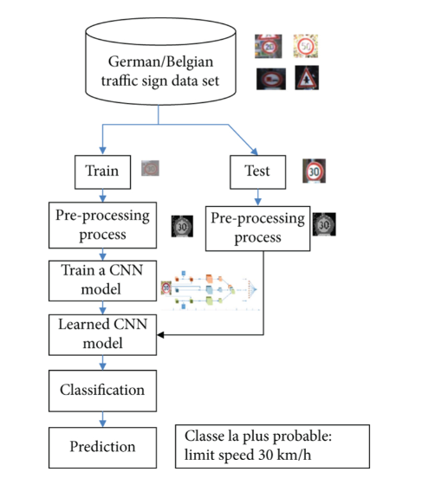

FLOWCHART

Slide 10
CONCLUSION
The experimental results prove that the proposed algorithm is efficient for real-time systems.
The objective of this project is to assist the driver in traffic conditions and warn him about the rules to reduce accidents.
Traffic sign detection and recognition system have been developed which has excellent execution under testing conditions
For example, to a significant degree dim brightening, immersed foundation, fractional impediments and broad scale varieties.
The proposed traffic sign board detection system can be used as a part of advanced driver assistance system to provide the safety information to the driver in real time.

